Slide 1
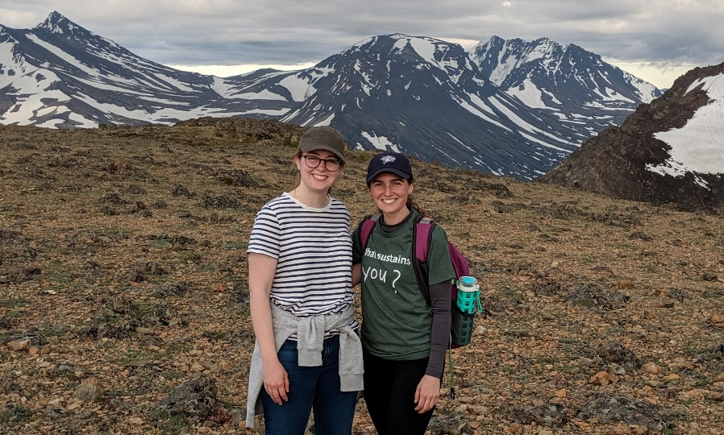
ADAC Year 6 Annual Meeting
ADAC Project Briefing
“ADAC Fellowship and ASIP Program”
ADAC Fellow, Jessica Manning, UNH
ADAC Fellow, Megan Verfaillie, UNH

Slide 2
Outline
ADAC Program Year 6 Annual Meeting 14 May 2019
Overview of Project
Overview of ADAC Fellowship Program
Arctic Summer Internship Program (ASIP
  ASIP Week 1 (Anchorage, AK)
  ASIP Week 2 (Utqiagvik, AK)
  ASIP Week 3 (Utqiagvik, AK)
  Building Beyond ASIP
Takeaways/Future
Notes:
Our perspectives on the program and what we gained from it

Slide 3
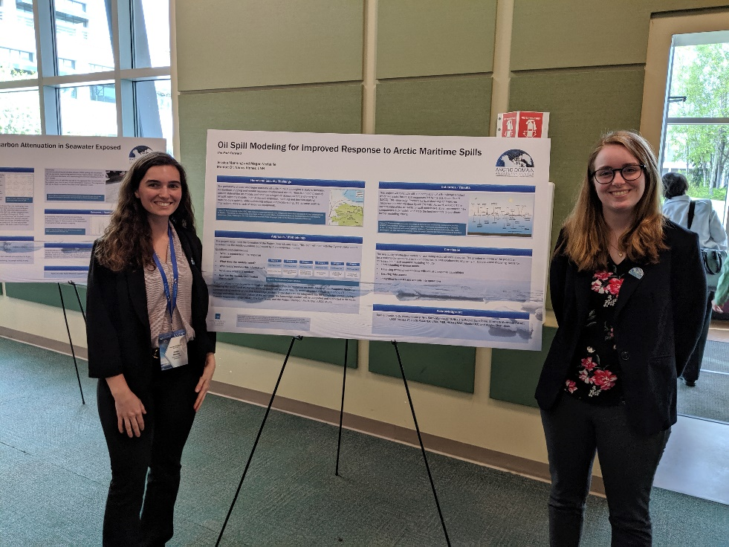
ADAC Fellowship: Project
ADAC Program Year 6 Annual Meeting 14 May 2019
Project: Oil Spill Modeling for Improved Response to Arctic Maritime Spills: The Path Forward (AMSM)
Project Champion: Captain Kirsten Trego
Project PI/Faculty Mentor: Dr. Nancy Kinner, UNH CRRC
Currently in Project Phase 4

Slide 4
ADAC Fellowship: Program
ADAC Program Year 6 Annual Meeting 14 May 2019
Workforce Development Program
  “Building tomorrow’s Homeland Security workforce”
Roles and Responsibilities:
  Attend monthly fellowship meetings
  Complete deliverables for fellowship program
  Present at workshops/conferences
  Completion of independent research projects
  Professional development and networking

Slide 5
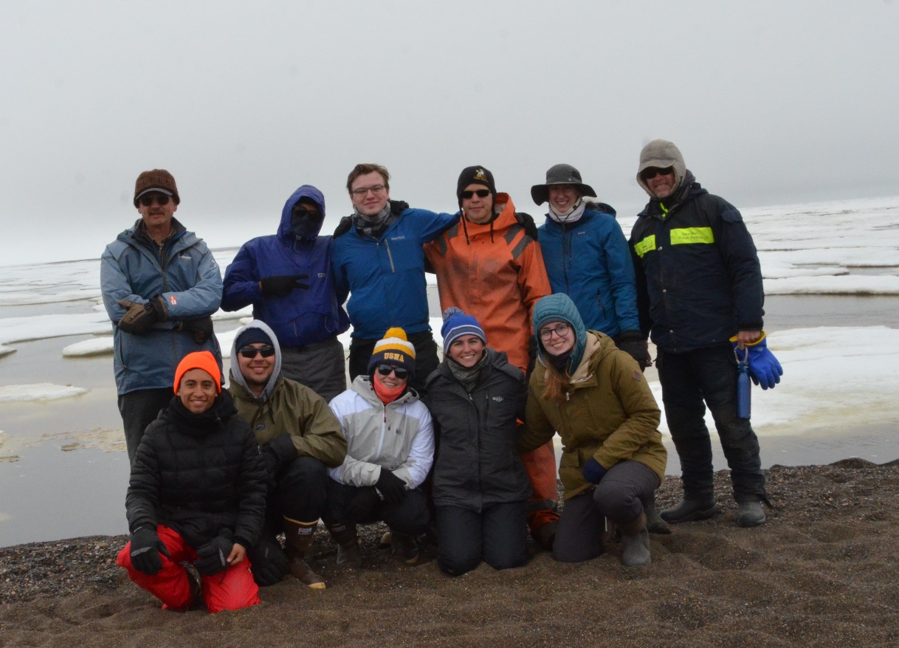
ADAC Fellowship: Arctic Summer Intern Program (ASIP)
ADAC Program Year 6 Annual Meeting 14 May 2019
Summer 2019
10 fellows from all over the U.S.
Three-week program
  One-week orientation in Anchorage, AK
  Two-weeks of field research in Utqiagvik (Barrow), AK
Notes:
Dr. Craig Tweedie, Randy Church Kee, Elizabeth Matthews, Jason Roe, Jeff Kee

Slide 6
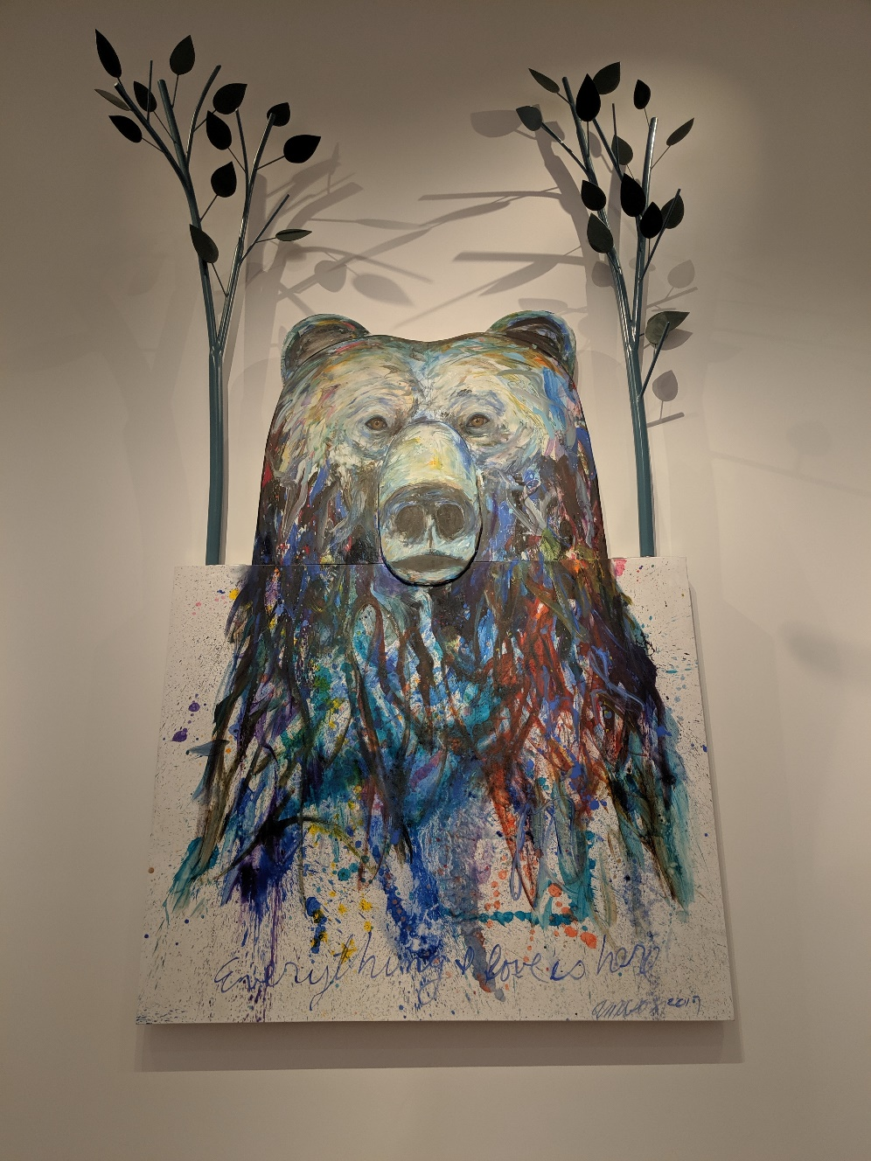
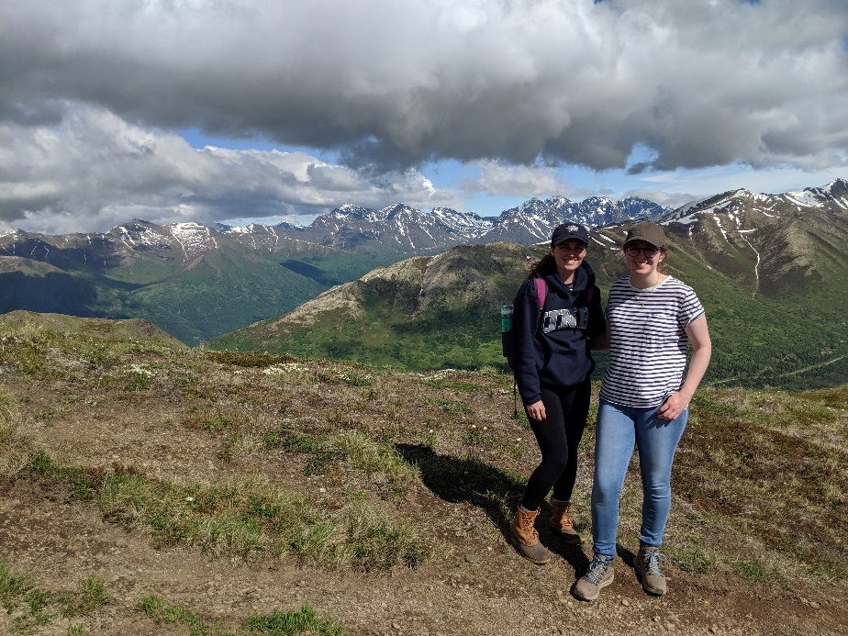
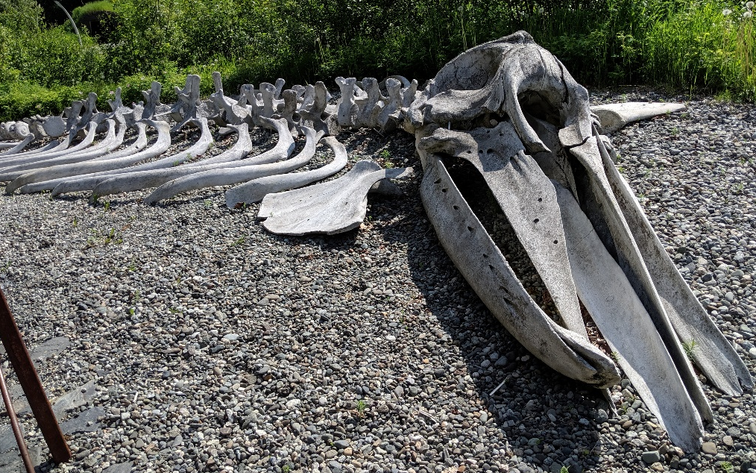
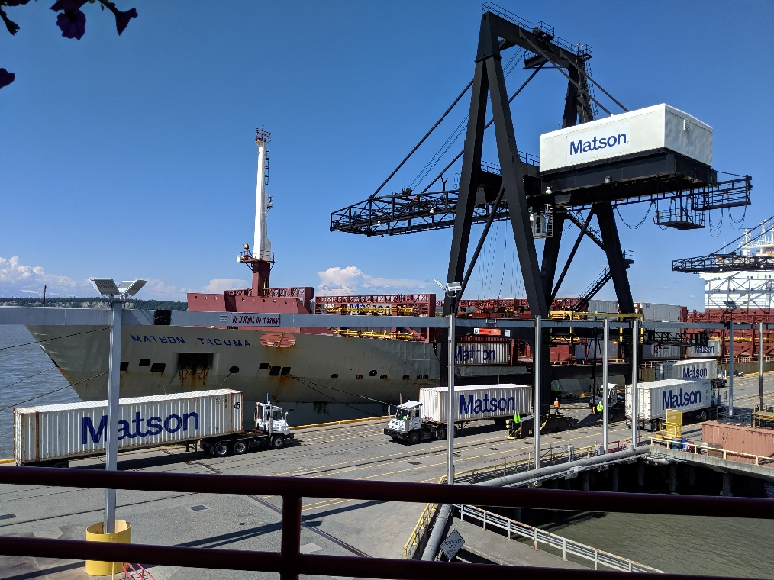
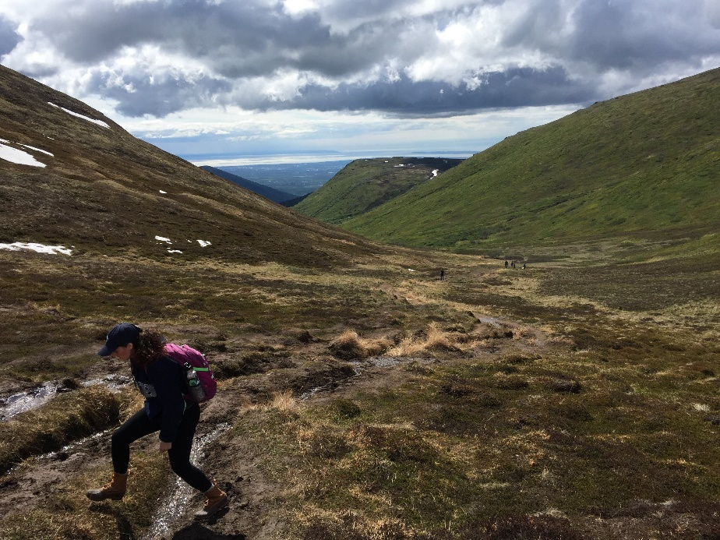
ADAC Fellowship: ASIP Week 1 (Anchorage, AK)
ADAC Program Year 6 Annual Meeting 14 May 2019
Notes:
Anchorage Museum, Alaska Native Heritage Center, Hike into the Mountains, Attended FEMA Preparedness Meeting, Visited the Port of Alaska, Attended a Number of Presentations, Toured Anchorage, Hung out with Other Fellows, Prepared for trip to Barrow

Slide 7
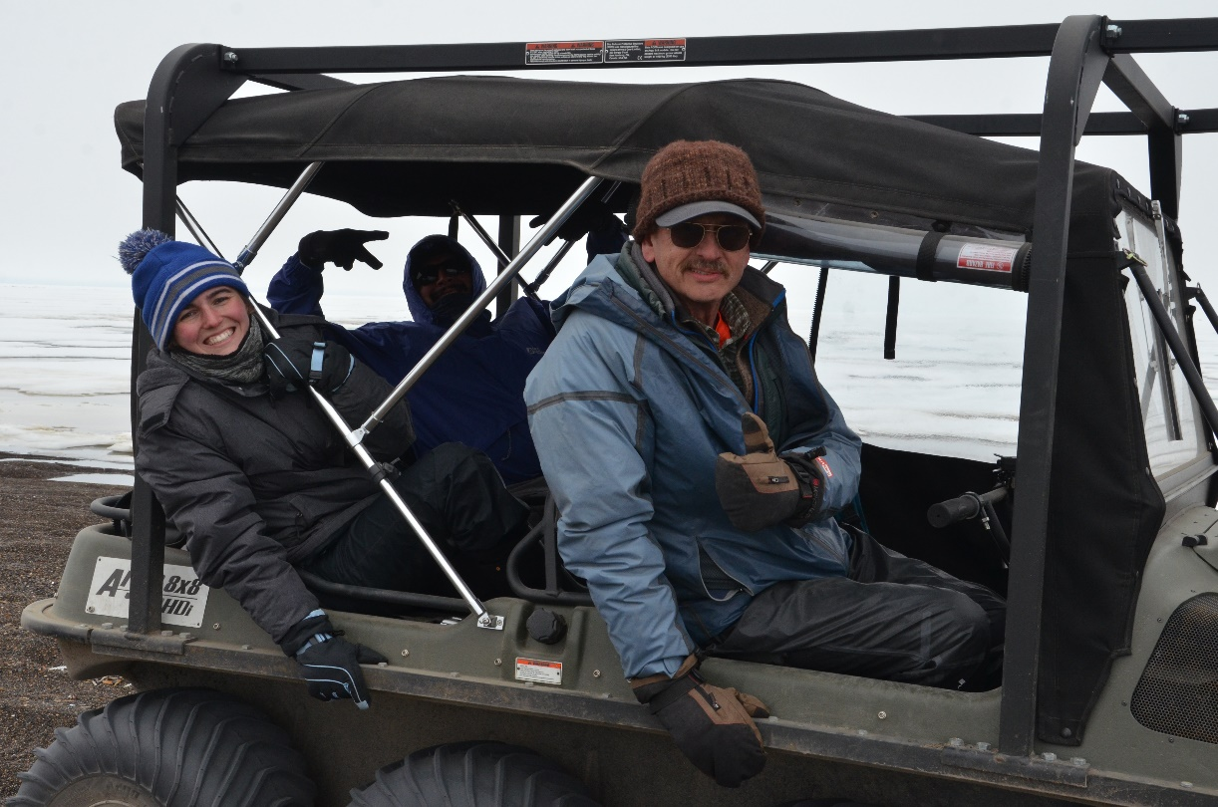
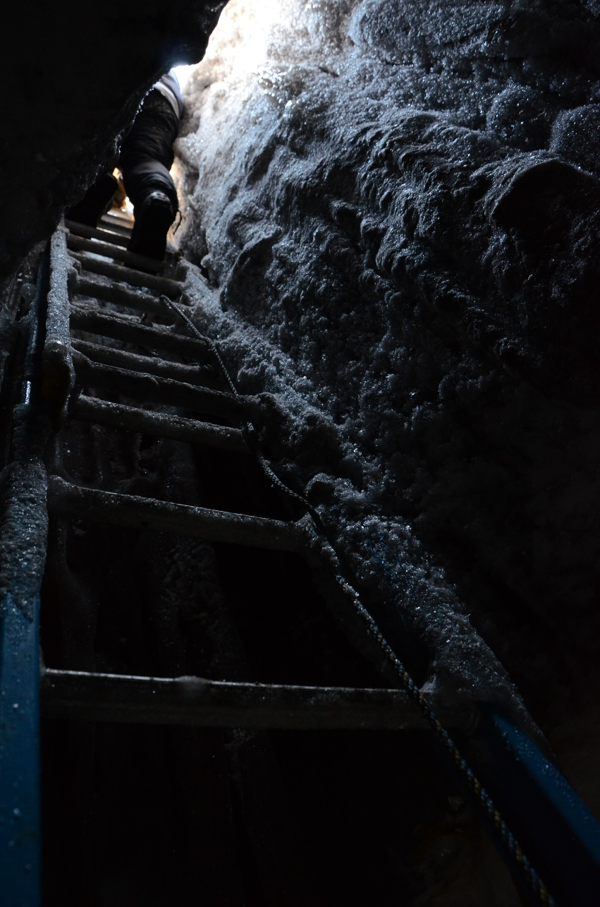
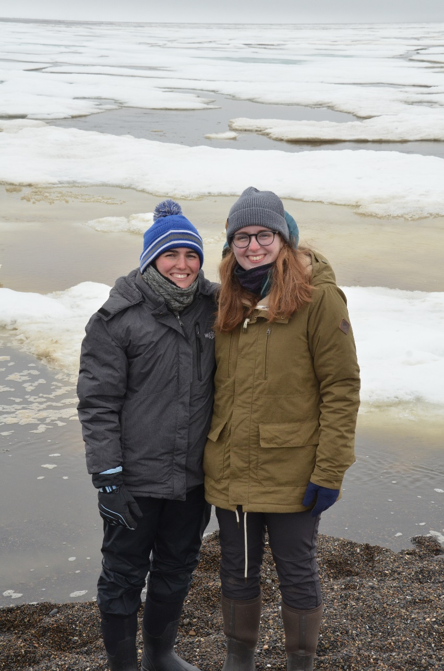
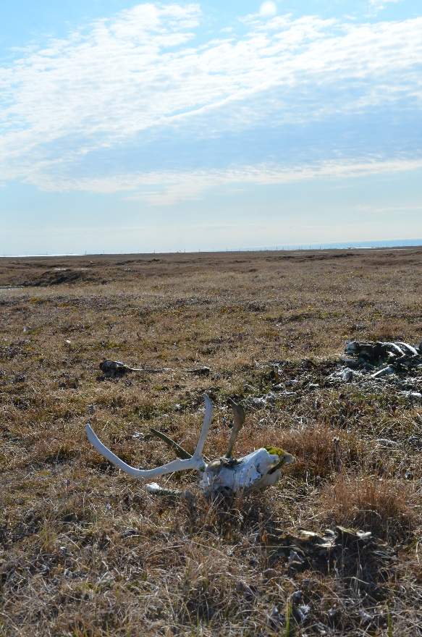
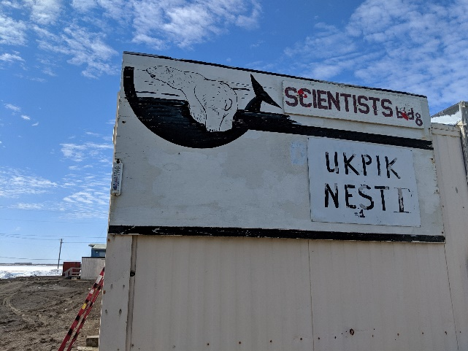
ADAC Fellowship: ASIP Week 2 (Utqiagvik, AK)
ADAC Program Year 6 Annual Meeting 14 May 2019
Notes:
Got settled, visited Plover Point, took a dive into permafrost

Slide 8
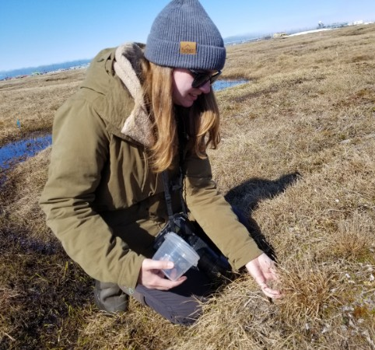
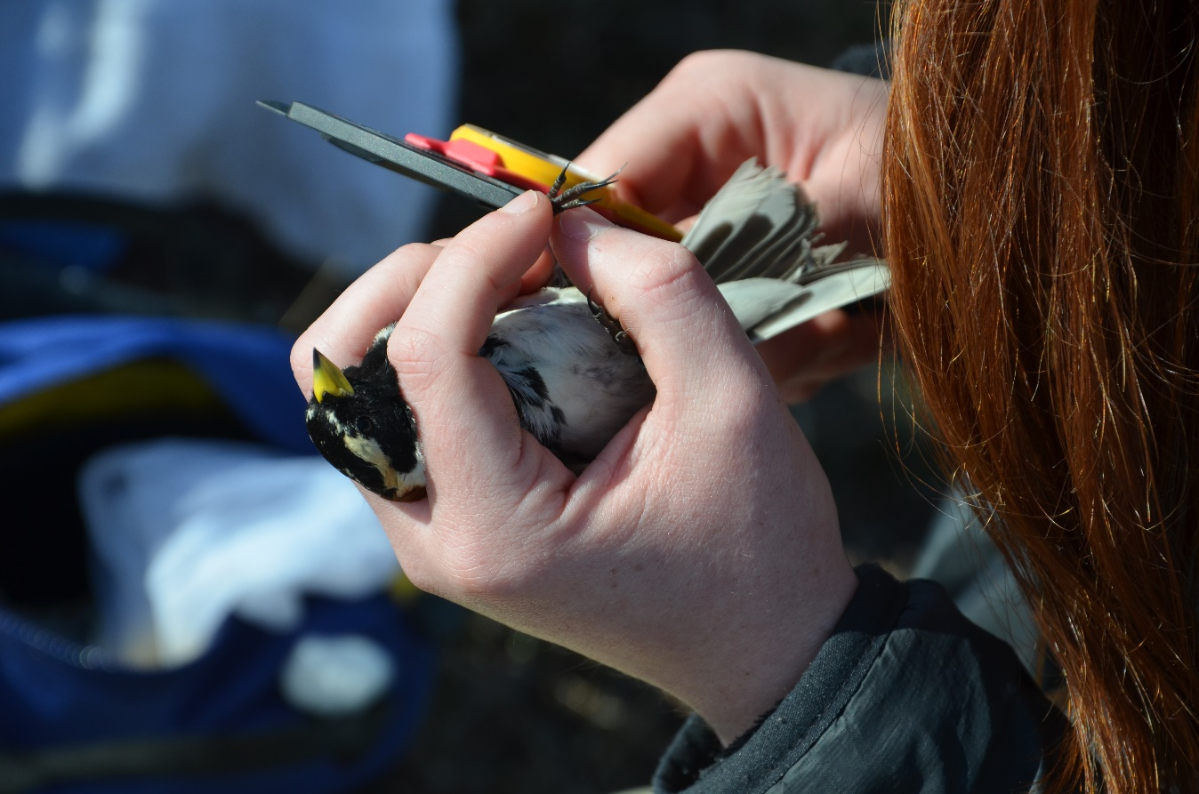
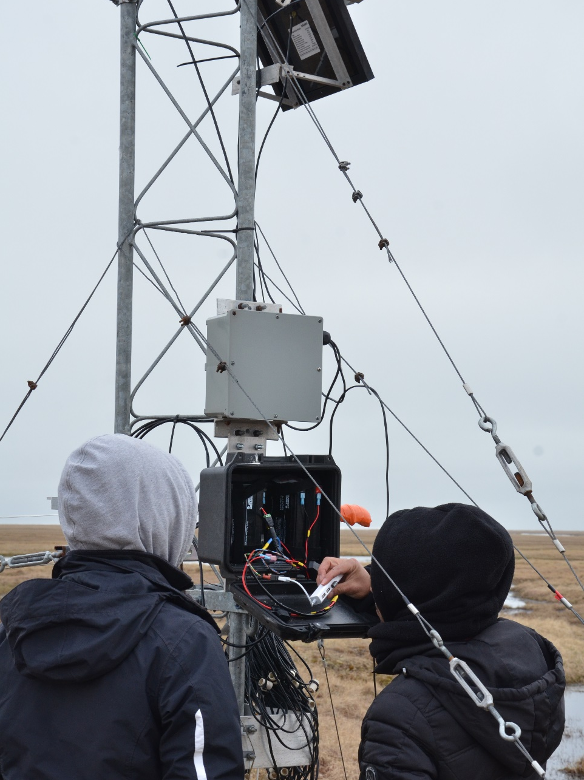
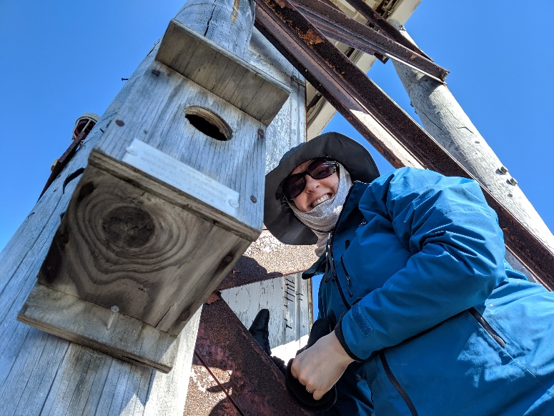
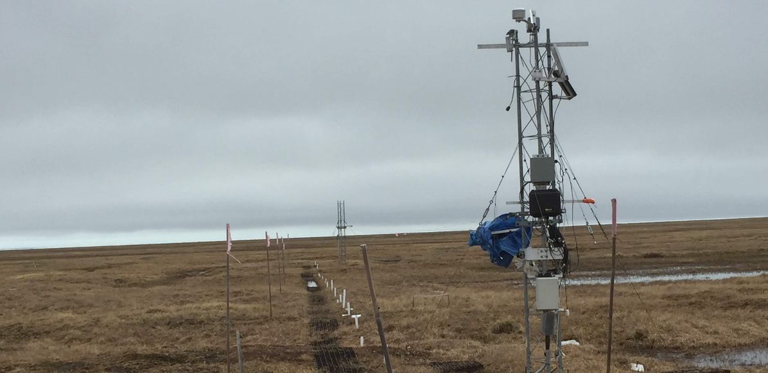
ADAC Fellowship: ASIP Week 2 (Utqiagvik, AK) – Megan
ADAC Program Year 6 Annual Meeting 14 May 2019

Slide 9
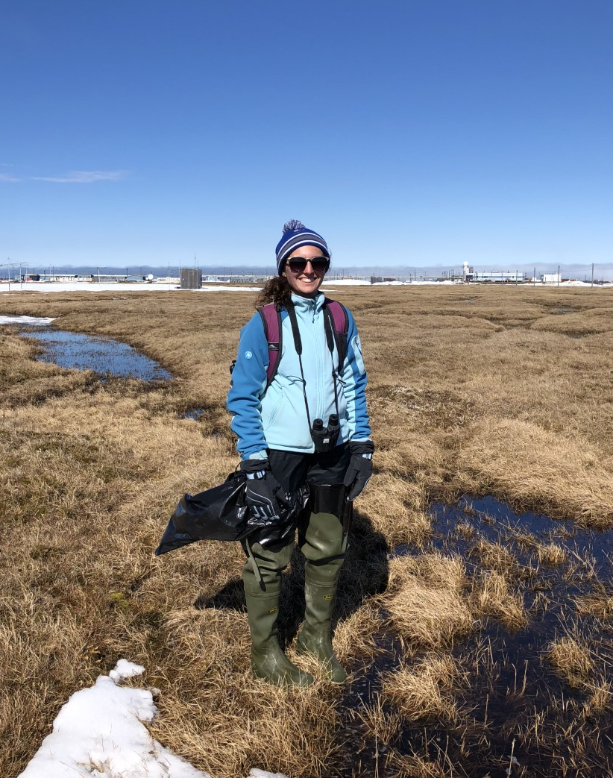
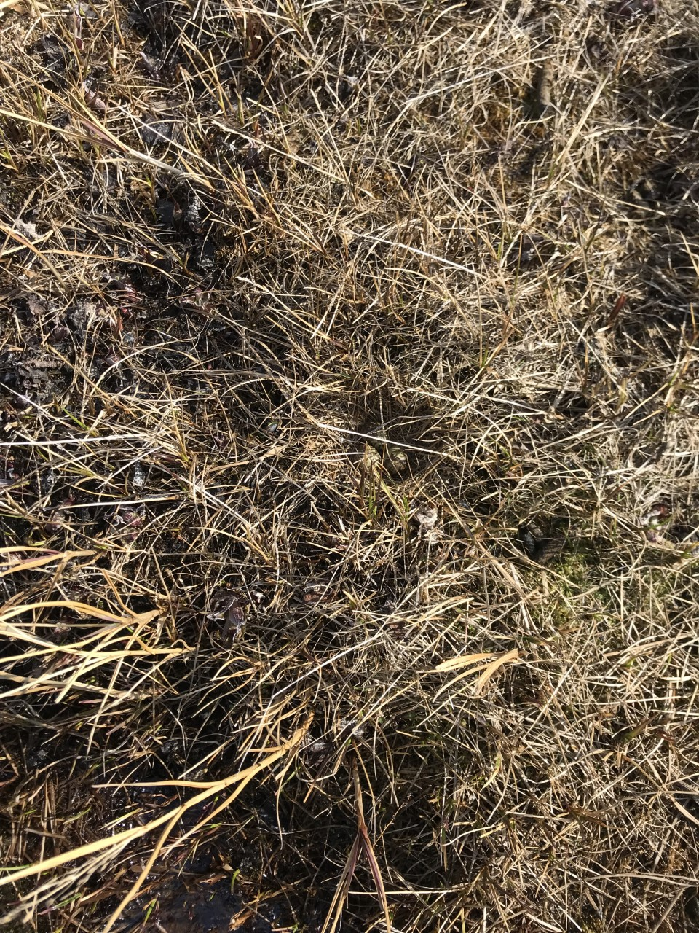
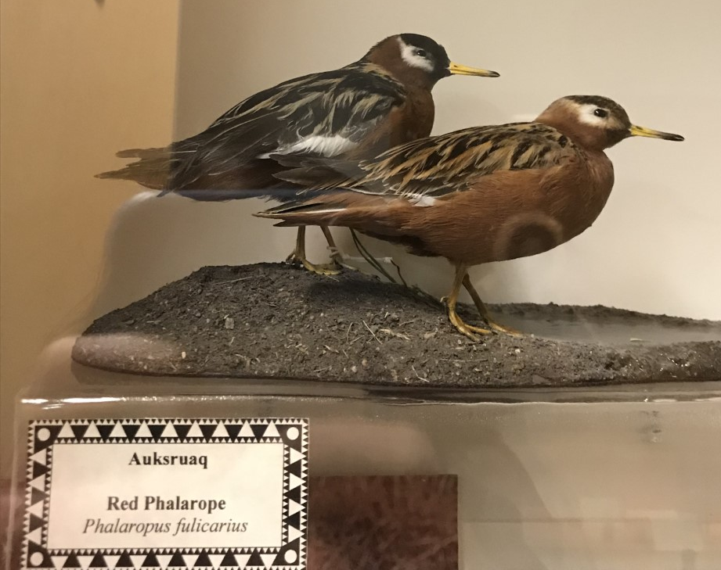
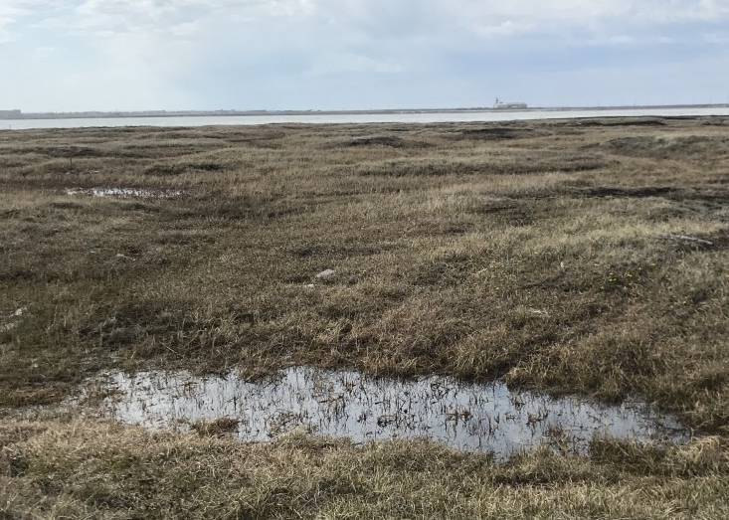
ADAC Fellowship: ASIP Week 2 (Utqiagvik, AK) – Jess
ADAC Program Year 6 Annual Meeting 14 May 2019

Slide 10
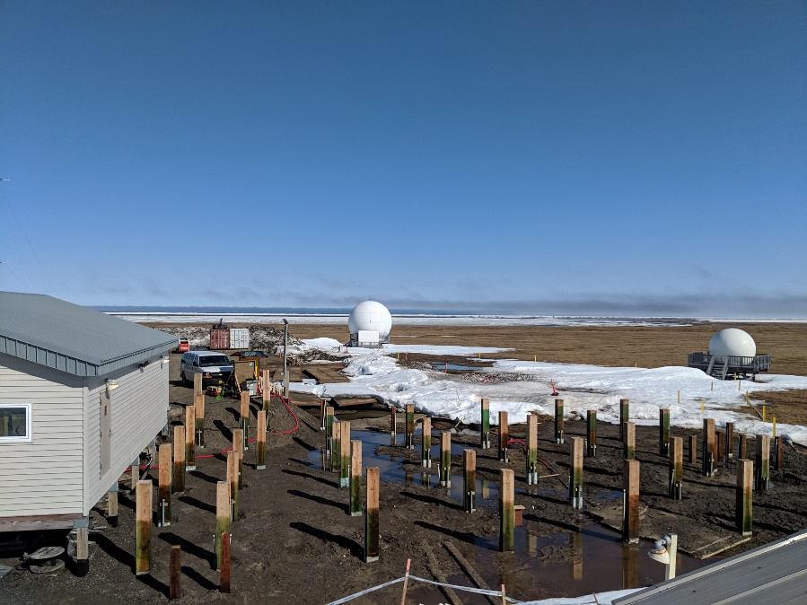
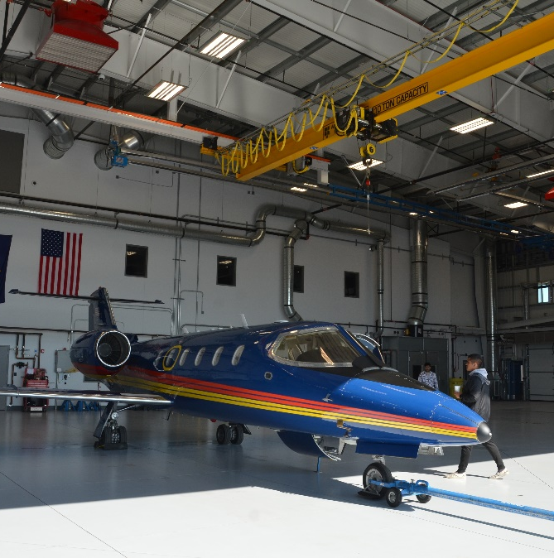
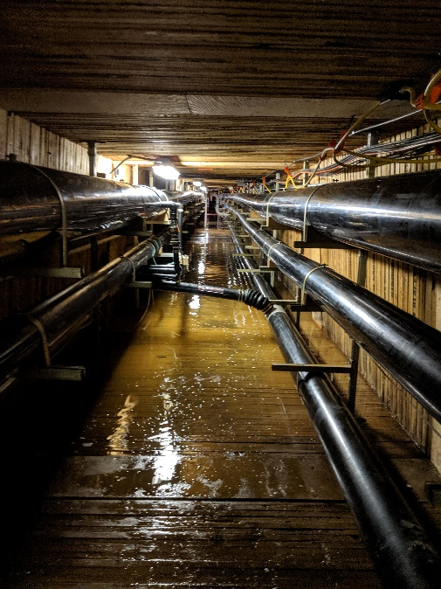
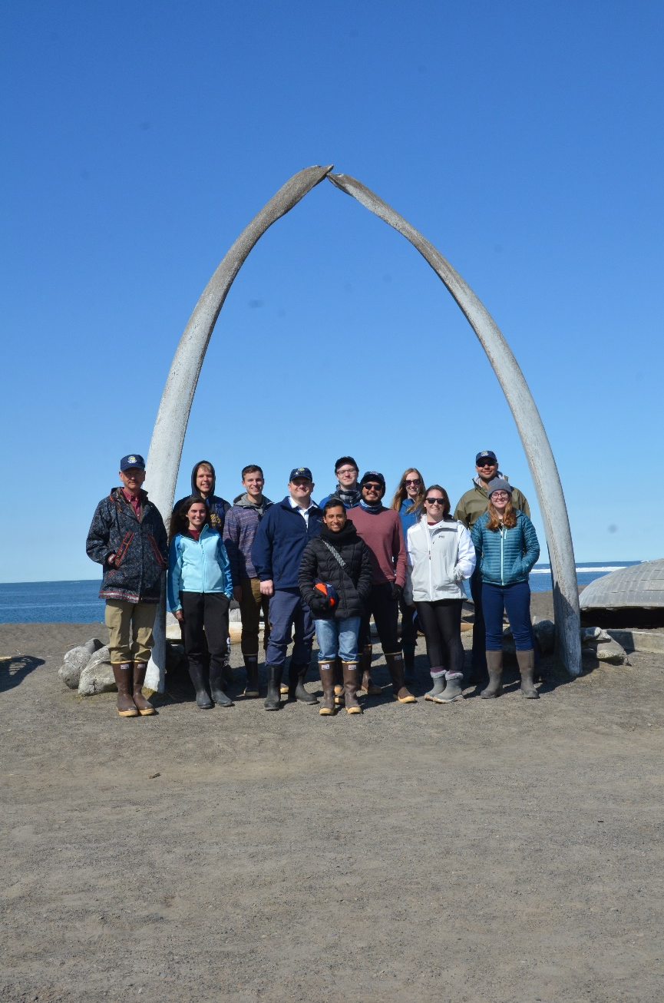
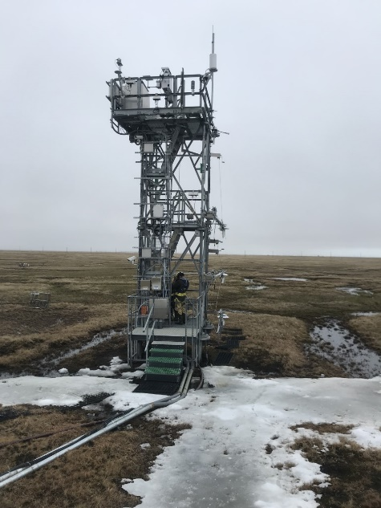
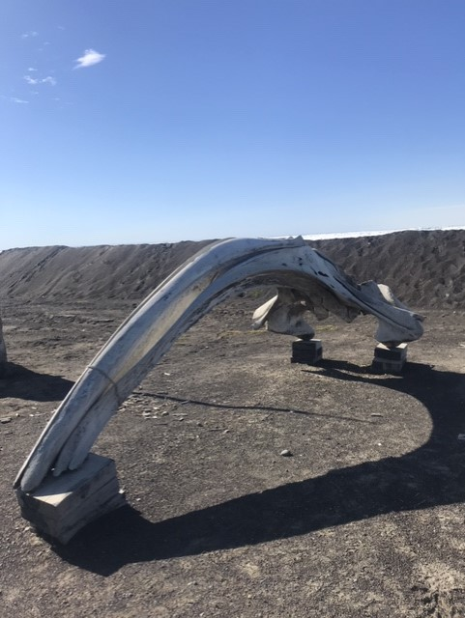
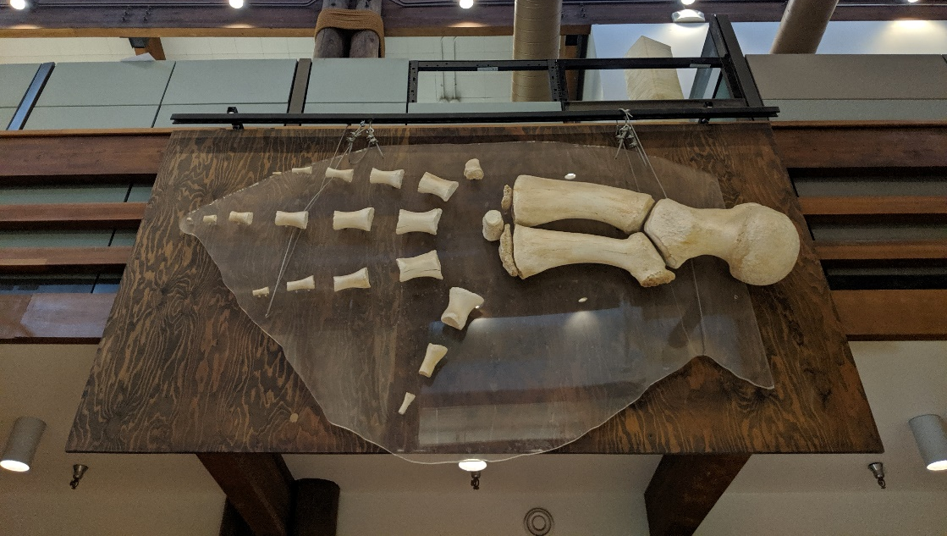
ADAC Fellowship: ASIP Week 3 (Utqiagvik, AK)
ADAC Program Year 6 Annual Meeting 14 May 2019
Notes:
Visited the Mayor, NOAA Recording Station, Search and Rescue, Nalukataq, ADAC Blue Economy Workshop, Wastewater Treatment System, Local Landmarks, Breakfast with the President of UAA

Slide 11
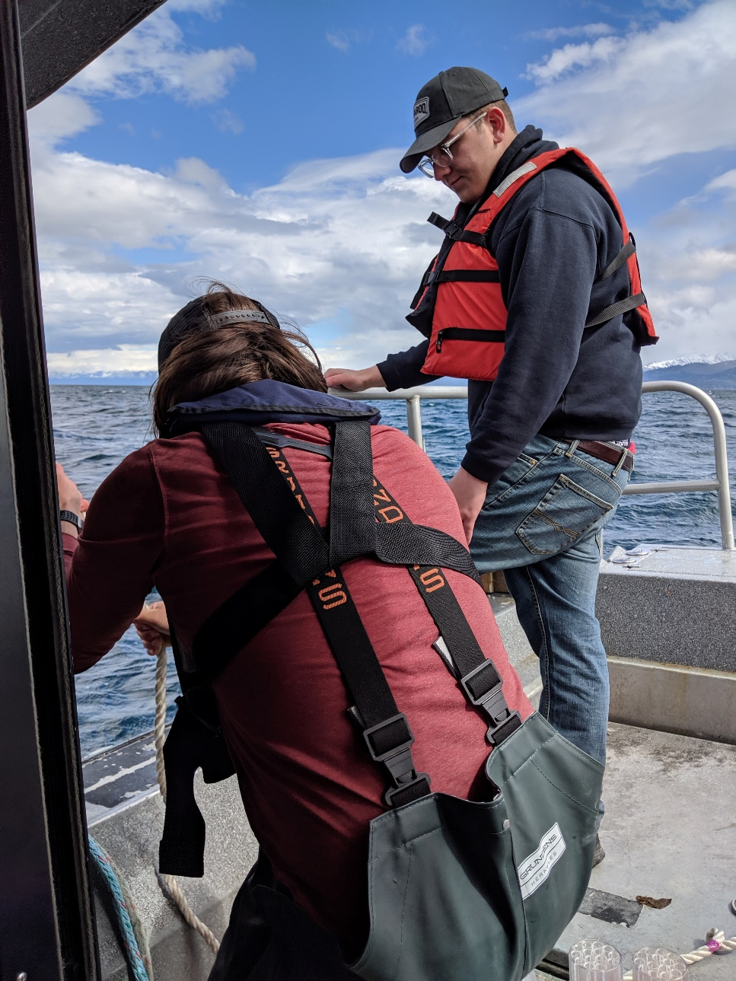
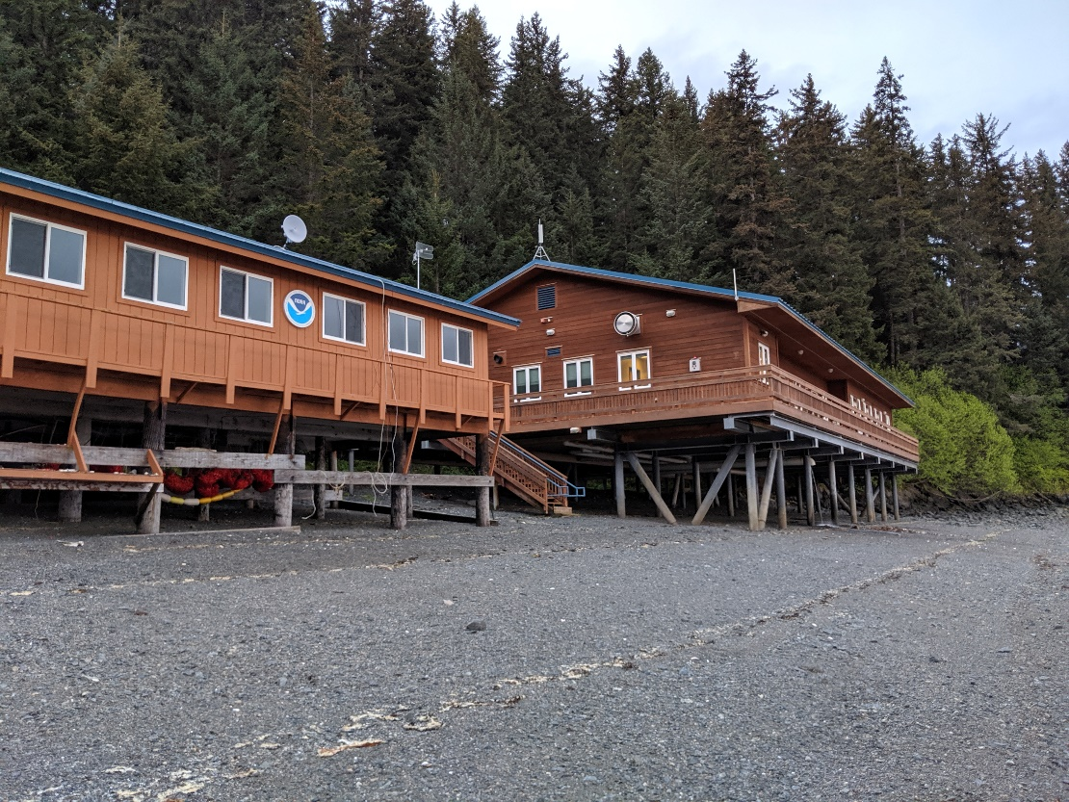
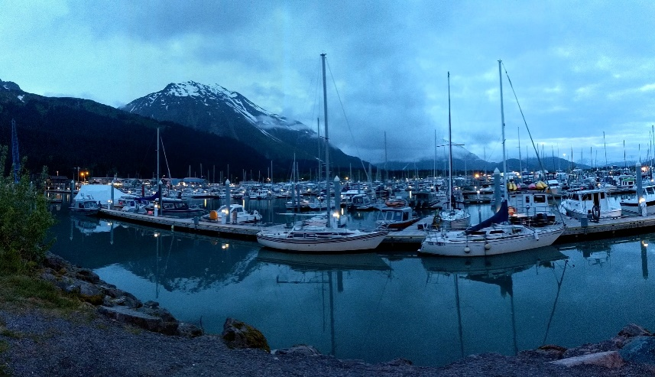
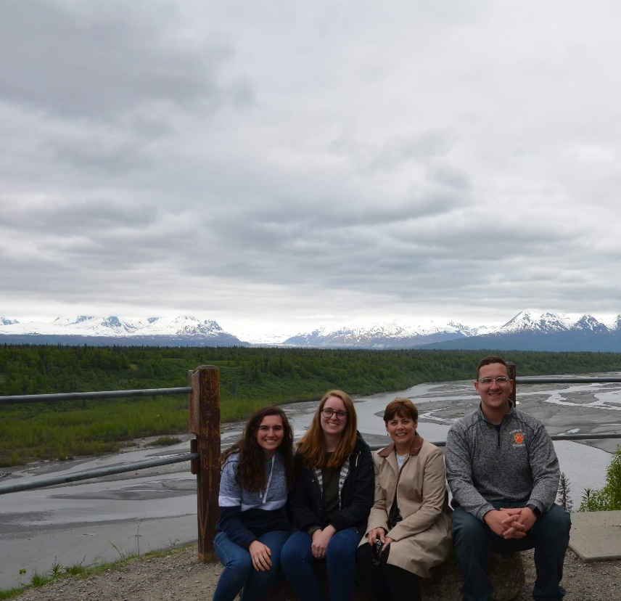
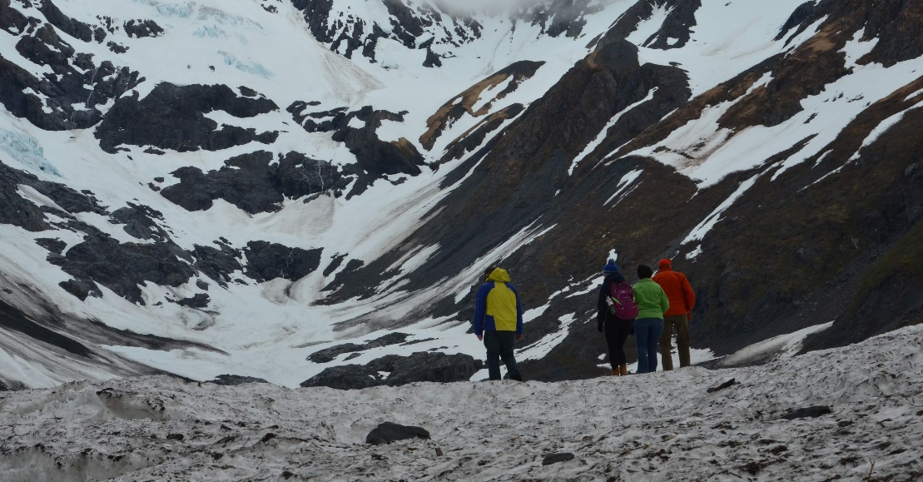
ADAC Fellowship: Building Beyond ASIP
ADAC Program Year 6 Annual Meeting 14 May 2019
Notes:
Arctic IONS, meeting with our project Core Team, visiting the NOAA K-Bay Lab, Alaska Sea Life Center in Seward

Slide 12
ADAC Fellowship: Conclusion
ADAC Program Year 6 Annual Meeting 14 May 2019
Major Takeaways:
  Opportunity to see, understand, and experience the U.S. Arctic
  Provided perspective for Arctic Issues
  Learn about Alaska Native culture
Future Plans
  Jess graduates May 2021 from Undergraduate
  Megan graduates May 2021 from Graduate Program

